Slide 1
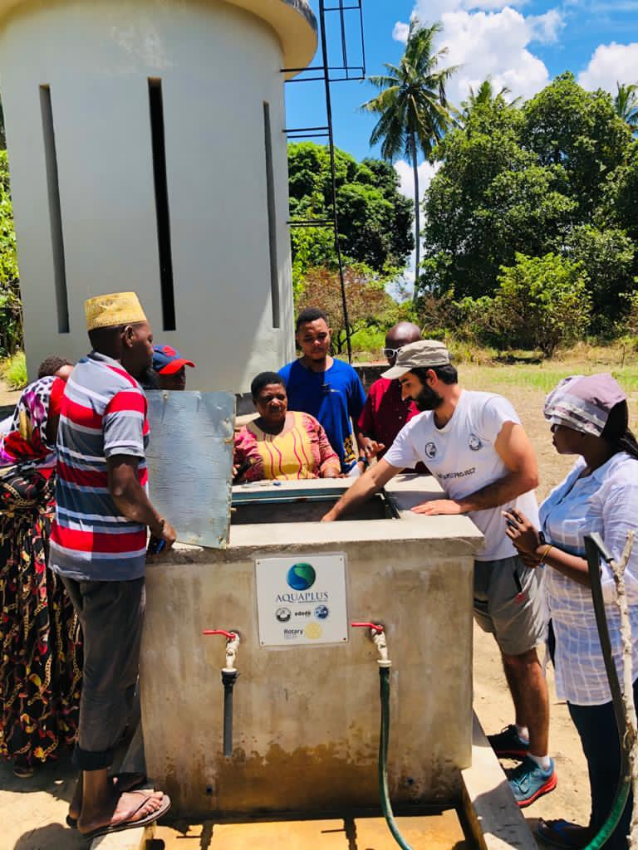

Slide 2
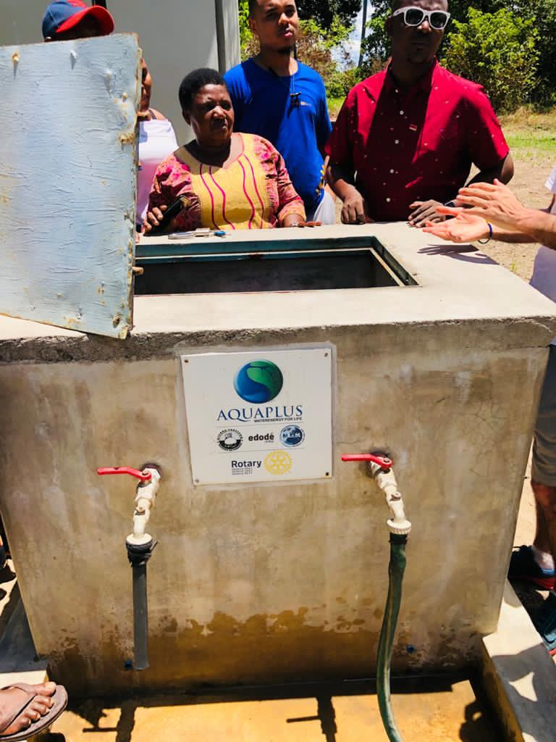

Slide 3
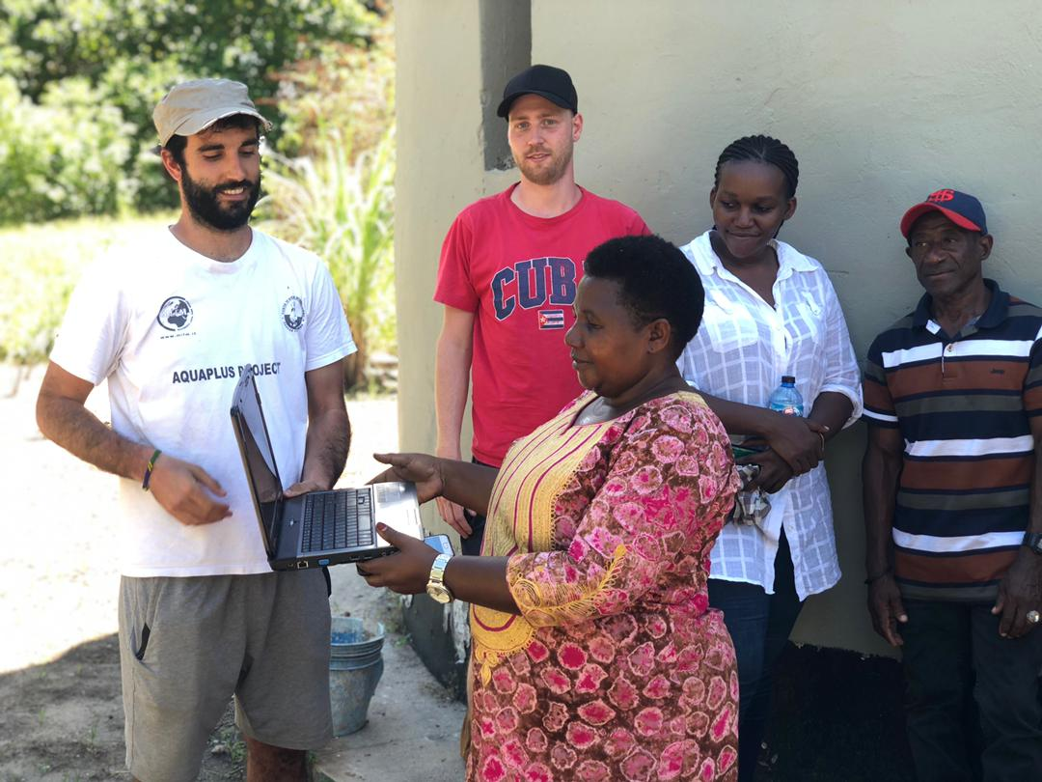
Donation of PC with Software application for the cost and financial management of the water distribution service for the project sustainability.
Mrs. Eng. Maria Pascal get the PC donated from District 2041 through Mr. Matteo Biffi.

Slide 4
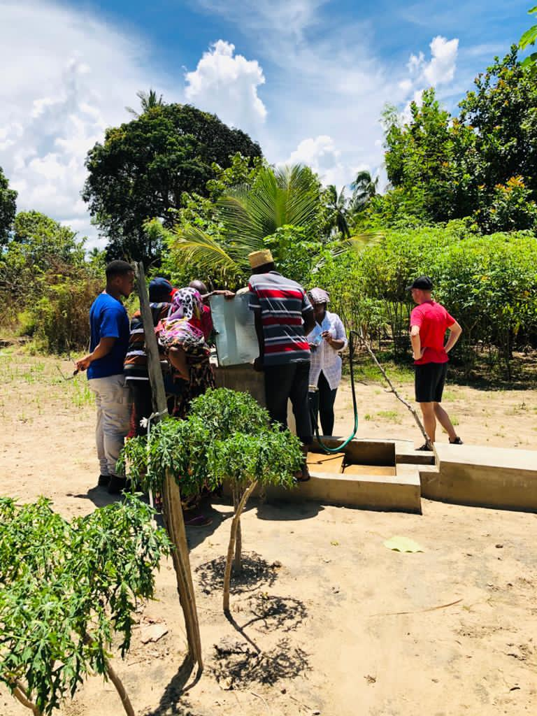

Slide 5
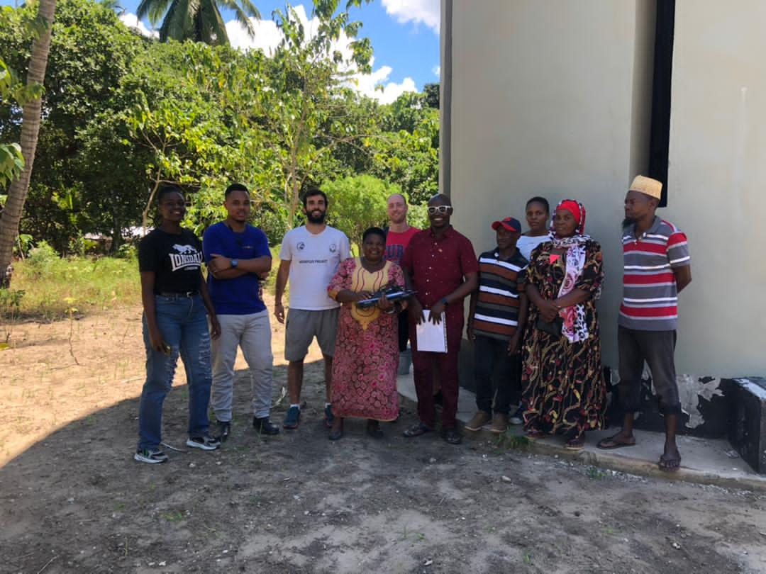

Slide 6
